Slide 1
Legislative Update: Here We Go Again

Slide 2
Agenda:
Bills from 2024
The new legislature
What’s the 411
2025 Preview
Q&A?

Slide 3
Bills from 2024

Slide 4
Governor Newsom took action on 1,206 bills this legislative session. He signed 1,017 bills and vetoed 189 bills, giving him a veto rate of 15.7%.
Notes:
NG

Slide 5
2024: A Snapshot
Academic Affairs
SB 1244 (Newman): CCAP Partnerships – Nursing
SB 895 (Roth): Community college BSN Pilot Program – AB 2104 (Soria): Community college BSN Pilot Program
Title IX
See subsequent list
Student Services
AB 1818 (Jackson): Overnight Student Parking Lots AB 2193 (Holden): Civil Liability for Hazing AB 2821 (Grayson) students with disabilities
Financial Aid and Fees
AB 1160 (Pacheco): Student Debt Collection
Employee-Employer Relations
AB 2088 (McCarty): Senior Management Employees
AB 2421 (Low): Confidential Communications
AB 2277 (Wallis): Part-Time Faculty Instructional Hours
Reserves
SB 1388 (Archuleta): Education finance: community colleges: general fund balance

Slide 6
League Supported Bills
AB 2104 (Soria): Baccalaureate Degree in Nursing Pilot Program Vetoed by the Governor
SB 895 (Roth): Baccalaureate Degree in Nursing Pilot Program Vetoed by the Governor
Would have authorized 10 community college districts to offer a Bachelor of Science in Nursing degree. The Chancellor would identify eligible community college districts based on specified criteria.
Would have authorized 10 community college districts to award Bachelor of Science in Nursing (BSN) degrees. Participating districts must have a nationally accredited Associate Degree in Nursing (ADN) program.
Notes:
NG

Slide 7
SB 895 Support
Adventist Health White Memorial
AFSCME
Antelope Valley CCD
Association of CCC Administrators
Association of CA Healthcare Districts
Bakersfield College
Butte College
Cabrillo CCD
CA Assisted Living Association
CAHSAH
CA Association of Health Facilities
CA Association of Latino CC Trustees & Administrators
CCC Baccalaureate Association
CCC Chief Instructional Officers
California Community Colleges Chancellor’s Office
CA Hospital Association
CCLC Asian Pacific Islander Trustee & Administrator Caucus
Cerritos CCD
Chabot-Las Positas CCD
Citrus College
Coast CCD
Compton CCD
Contra Costa CCD
County Health Executives Association of CA
County of LA Board of Supervisors
Desert CCD
El Camino CCD
FACCC
Foothill-De Anza CCD
Gavilan College
Glendale CCD
Grossmont College
Grossmont-Cuyamaca CCD
Kern CCD
Lassen CCD
Lemoore College
Long Beach CCD
LA Area Chamber of Commerce
Los Angeles CCD
Los Angeles Pierce College
Los Angeles Valley College
MiraCosta CCD
Monterey Peninsula CCD

Slide 8
SB 895 Support
Moorpark College
Mt. San Antonio College
Mt. San Jacinto CCD
North Orange County CCD
Palo Verde CCD
Palomar CCD
Pasadena Area CCD
Peralta CCD
Providence
Rancho Santiago CCD
Redwoods CCD
Rio Hondo College
Riverside CCD
San Diego CCD
San Diego Unified School District
San Jose-Evergreen CCD
San Luis Obispo County CCD / Cuesta College
Santa Clarita CCD - College of the Canyons
Sharp Healthcare
Sierra CCD
Siskiyou Joint CCD
South Orange County CCD
Southwestern CCD
Student Senate for CA Community Colleges
Sutter Health
TELACU
United Nurses Associations of California
Ventura County CCD
Victor Valley College
West Hills CCD
West Kern CCD
75+ colleges,
hospitals, nursing
& health orgs
support SB 895

Slide 9
League Opposed Bills
AB 2277 (Wallis): Community colleges: part-time faculty Vetoed by the Governor
AB 2088 (McCarty): Part-time or full-time vacancies Vetoed by the Governor
Would have required K-12 and community colleges to offer classified employees the right of first refusal to an open position on campus for 10 business days before the employer may offer the position to an external candidate.
Would have increased the maximum amount of instructional hours that a part-time California Community College faculty member may teach at any one community college district.
Notes:
KP

Slide 10
Adjuncts sue California community college system, eight local districts over unpaid work hours October 25, 2022
Seven part-time community college professors across California have sued eight local districts where they teach and the state, claiming their job requires that they work unpaid hours preparing lessons, grading and meeting with students, court records show.
They are demanding back pay, changes that will ensure they are paid for the work in the future, and for a judge to declare the suit a class action that could sweep in other part-time academics, commonly called adjuncts. As many as 37,000 adjuncts teach in the 115 colleges.

Slide 11
Part Time Faculty Districts with active litigation
Board of Governors or the California Community College
Sierra Joint Community College District
Monterey Peninsula Community College District
Sequoias Community College District
Desert Community College District
Palomar Community College District
Contra Costa Community College District
San Mateo Community College District
Peralta Community College District
Shasta-Tehama Trinity Joint Community College District
Butte-Glenn Community College District
Yuba Community College District
Los Rios Community College District
Mt. San Jacinto Community College District
San Diego Community College District
Cerritos Community College District
Los Angeles Community College District
San Joaquin Delta Community College District
Mt. San Antonio Community College District
Foothill-Deanza Community College District
Yosemite Community College District
Pasadena Area Community College District
Santa Clarita Community College District
Long Beach Community College District

Slide 12
AB 1818 (Jackson): Homeless Students: Parking
Requires 20 CCC and 5 California State University (CSU) campuses to develop a safe parking lot pilot program, allowing overnight parking by a homeless student if the student uses their vehicle as housing.
While the author agreed to amendments to make the pilot program contingent upon an appropriation, this bill was identified as putting Proposition 98 General Fund and General Fund cost pressures in the low tens of millions of dollars for the duration of the program to fund the pilot programs at CCC and CSU campuses.
Measure Failed-Held by Senate Appropriations due to costs

Slide 13
SB 1388 (Archuleta): Education finance: community colleges: general fund balance
This bill would prevent community college districts from having reserves over 16.7% unless the district has met the 75% full-time faculty obligation number, participates in the Part-Time Community College Faculty Health Insurance Program, and participates in the Community College Part-Time Faculty Office Hours Program.
The bill also restricts a district from transferring unrestricted general funds to another fund. If a district violates this provision, reserve funds over 16.7% would have to be distributed to nonsupervisory and nonmanagement employees.
Measure Failed-Held by Senate Appropriations due to costs

Slide 14
SB 1388 NASCAR Letter

Slide 15
AB 1160 (Pacheco): Debt Collection
Requires all higher education institutions to grant a one-time exemption from an enrollment or registration hold on a current or former student on the grounds that the student owes an institutional debt. This bill would also limit lost funds from being recouped through the Chancellor’s Office Tax Offset Program (COTOP).
Measure Failed-Held by Senate Appropriations due to costs

Slide 16
AB 2193 (Holden): Hazing Accountability
Establishes civil liability for a higher education institution by a person harmed by hazing from an organization affiliated with the institution with a rebuttable presumption that the institution took reasonable steps to stop the hazing.
Signed by the Governor

Slide 17
AB 2421 (Low): Employer-employee relations: Confidential Communications
This bill would prohibit most public employers, including a higher education employer or the district from questioning any employee or employee representative regarding communications made in confidence between an employee and an employee representative in connection with representation relating to any matter within the scope of the recognized employee organization’s representation.
Measure Failed-Held by Senate Appropriations due to costs

Slide 18
AB 2821 (Grayson) Students with disabilities
Requires the Chancellor of the California Community Colleges (CCC) and the Trustees of the California State University (CSU) and requests the University of California (UC) and the governing boards of independent institutions of higher education, to provide as part of existing college personnel onboarding and training, a Disability Access and Compliance Training Program (DACTP).
Signed into law

Slide 19
SB 1244 (Newman)
College and Career Access Pathways (CCAP) Program
Authorizes a district to enter into a CCAP partnership with a K-12 LEA located within the service area of another CCD if the CCD in the service area has declined a request from the LEA or has failed to take action within 60 calendar days of a request by the LEA to either enter into a CCAP partnership.
Signed into law

Slide 20
Federal Changes to Title IX - Court Vacates 2024 Title IX Policies
On January 9, 2025, the U.S. District Court for the Eastern District of Kentucky issued a ruling in State of Tennessee v. Miguel Cardona, Civil Action No. 2:24-072-DRC, invalidating the U.S. Department of Education’s 2024 Title IX regulations.
The court set aside the 2024 regulations in their entirety, rather than opting to sever the language in the regulations challenged by the plaintiffs, finding that the regulations went far beyond the law’s original purpose.

Slide 21
Federal Changes to Title IX - Court Vacates 2024 Title IX Policies
The Kentucky court’s vacatur has the effect of taking the 2024 regulations “off the books.” The ruling did not have any effect on the 2020 Title IX regulations. Thus, until schools, colleges, and universities receive further guidance from the U.S. Department of Education, they should revert to the procedures in place before August 1, 2024.

Slide 22
Title IX Legislation
AB 810 (Friedman): Hiring practices: academic, athletic, and administrative appointments.
AB 1575 (Irwin) Public postsecondary education: sexual harassment, sexual violence, and discrimination: disciplinary actions: confidential advocates and advisers.
AB 1905 (Addis): California State University: terms of employment.
AB 2047 (M. Fong): Postsecondary education: discrimination prevention: systemwide office.
AB 2048 (M. Fong): Discrimination prevention: campus-based offices.
AB 2326 (Alvarez): Sex discrimination policies.
AB 2407 (Hart): Public postsecondary educational institutions: sexual harassment complaints: state audits.
AB 2492 (Irwin): Public postsecondary education: sex discrimination complaints: advocates and coordinators.
AB 2608 (Gabriel): Sexual violence and sexual harassment: training.
AB 2987 (Ortega) Sex discrimination complaints: status updates and notices. SB 1166 (Dodd): Prevention of discrimination.
SB 1491 (Eggman): Disclosures: Equity in Higher Education Act: Title IX: exemptions.

Slide 23
Overarching Thoughts on Bill Title IX Package
By product of Assembly report –not a one and done issue.
The goal is to provide adequate funding to ensure successful implementation (Budget request was made, but failed).
Bills seem to suggest that each campus should have dedicated staff with dedicated purposes and dedicated space. Burnout to existing employees in this field.
It’s unclear if there are enough qualified employees available to fill all of the positions envisioned by report.
Interplay of 50% and the significant number of new employees is an important consideration.

Slide 24
AB 2608 (Gabriel): Postsecondary education: sexual violence and sexual harassment: training
This bill requires all higher education institutions to update their annual sexual violence and sexual harassment training for students.
To include additional topics, including how to recognize if someone is at risk of drug-facilitated sexual assault.
Signed into law

Slide 25
Reporting and Auditing
SB 1166 (Dodd): Public postsecondary education: annual report: sex discrimination
Requires districts to report to the Chancellor’s office on they ensure campus programs and activities are free from sex discrimination. The Chancellor’s office must file this report once a year with the state legislature.
Signed into law
AB 2326 (Alvarez): Public postsecondary education: sex discrimination policies
Locally elected board and the CEO must ensure their colleges are free from discrimination. The President of the Board and Chancellor would be required to present to the Budget subcommittees the annual report.
Signed into law
AB 2407 (Hart): Public postsecondary educational institutions: sexual harassment complaints: state audits
The California State Auditor, by January 1, 2026, and every 3 years thereafter, to conduct an audit of the CCC, the CSU, and the UC regarding their respective handling and investigation of sexual harassment complaints.
Signed into law

Slide 26
Employment: Hiring and Termination
AB 810 (Friedman): Postsecondary education: hiring practices: academic, athletic, and administrative appointments
Requires the governing board of a CCC to have an applicant disclose if they had any final administrative decision or final judicial decision of sexual harassment in the last seven years from previous employers.
Signed into law
AB 1905 (Addis): Public postsecondary education: employment: settlements, informal resolutions, and retreat rights
Each governing board must adopt a written policy on settlements and informal resolutions of complaints of sexual harassment in cases where the respondent is an employee of the institution and would require final action by the board of a community college district.
Signed into law

Slide 27
Strengthening Protocols and Staff on Sexual Assault and Harassment
AB 2047 (M. Fong): Postsecondary education: discrimination prevention: systemwide office
Creates a systemwide Title IX and nondiscrimination office, reporting directly to the systemwide governing board, with the responsibility to ensure compliance of each college’s Title IX office. This measure only applies to CSU and UC.
Signed into law
AB 2492 (Irwin): Public postsecondary education: sex discrimination complaints: advocates and coordinators
This bill requires each public postsecondary education institution to establish a confidential student advocate to assist students who have filed a complaint of sex discrimination, confidential staff and faculty advocate, and a confidential respondent services coordinator. These positions would be independent from of a Title IX office, including the Title IX coordinator.
Measure Failed-Held by Senate Appropriations due to costs
AB 1575 (Irwin): Public postsecondary education: sexual harassment, sexual violence, and discrimination: disciplinary actions: confidential advocates and advisers
Each public segment must adopt a policy permitting a student to be represented by an adviser if the student receives a notification of disciplinary action. The adviser may be a confidential advocate.
Signed into law

Slide 28
AB 2987 (Ortega) sex discrimination complaints: status updates and notices
Requires each campus of the three public segments to provide status updates on complaints of sex discrimination, and a notification of the disciplinary action to the respondent and complainant, within five business days of a decision of disciplinary action being made against a respondent in response to a complaint of sex discrimination.
Signed into law

Slide 29
AB 2048 (M. Fong): Postsecondary education: discrimination prevention: campus-based offices
The Chancellor of the California Community Colleges shall convene a community college sexual harassment and Title IX working group. Focusing on the review of policies and procedures of community college districts and determine if existing community college district policies and procedures regarding faculty-student and staff-student relationships and sexual harassment are adequate.
Signed into law

Slide 30
Chancellor’s Workgroup on Gender Equity in California Community Colleges
The workgroup includes representatives from:
Chief Executive Officer & Trustee Board Member
Chief Student Services Officer
Board of Governors Representative
Title IX Officer
Assembly Higher Education Committee Consultant
Purpose:
Setting baseline policies for sexual harassment prevention, detection, and response. Monitoring compliance with laws and regulations. Ensuring transparent reporting of sexual harassment complaints and outcomes.
Deadline: Report with recommendations are due by December 2025.

Slide 31
Legislation Refresh: Immigration Enforcement Issues in CCDs

Slide 32
History – Post-2016 President Election
January 25, 2017
President Trump signed Executive Order 13768 baring sanctuary jurisdictions from receiving federal funding
October 5, 2017
Assembly Bill 21 is passed establishing obligations for CCDs
Senate Bill 54 is passed establishing the California Values Act and prohibiting the use of state and local funds/resources for federal immigration enforcement
2021
President Biden rescinded Executive Order 13768

Slide 33
Status Today
President Trump promised mass deportation during the campaign
Assembly Bill 21 and Senate Bil 54 remain in effect in California

Slide 34
AB 21 – Access to Higher Education: Legislative Findings, Ed. Code § 66093
California’s colleges … have traditionally been beacons of free thought that challenge students in a peaceful, safe environment…
With great risks presented by changes to immigration policies and enforcement at the federal level, it is more important than ever to work to protect the students, faculty, staff, and the public, and ensure that, regardless of their immigration status, they can continue to take advantage of the education to which they are entitled, and are free from intimidation or loss of access to resources and programs that other students enjoy.

Slide 35
AB 21 – Access to Higher Education: Legislative Findings, Ed. Code § 66093
Ensure that the state’s students, faculty, staff, and the public have every opportunity to continue their education without fear or undue risk.

Slide 36
AB 21 – Ed. Code Section 6609.3 Obligations
Identify a single point of contact
Protect personal information of students, staff, and faculty
Notice of immigration enforcement activity
Notify emergency contact if person is believed to be taken into custody
Refer immigration officer or agent to the office of the chancellor/president/designee
Comply with judicial warrants, subpoenas or court orders to enter nonpublic places

Slide 37
AB 21 – Ed. Code Section 6609.3 Obligations
Legal services contact list
Provide free legal advice to students
List must be available to students for free
By March 1, 2019, implement model policy developed by AG’s Office limiting assistance with immigration enforcement only as required by federal and state law
Policies in compliance with AB 54

Slide 38
AB 21 – Ed. Code Section 6609.3 Obligations
Publish and distribute guidance information on rights under state/federal immigration laws and how to respond to a federal immigration action or order.
Assist undocumented students in case of detention or deportation to retaining any eligibility for financial aid, stipends, exemption from nonresident tuition fees, etc. and permit enrollment.

Slide 39
AB 450 Prohibits Voluntary Immigration Worksite Enforcement
Effective January 1, 2018, prohibits an employer from providing voluntary consent to an immigration enforcement agent to:
Enter nonpublic areas of the worksite, unless the agent has a judicial warrant, subject to a specified exception; and
Access, review, or obtain the employee records without a subpoena or court order, except if specified exception applies.

Slide 40
AB 450 Prohibits Voluntary Immigration Worksite Enforcement
Requires employers:
Provide current employees with notices of an immigration agency’s inspection of I-9 employment eligibility verification forms or other employment records within 72 hours of receiving the federal notice of inspection—using a template created by the labor commissioner.
Prohibits employers from re-verifying employment eligibility of a current employee when not required by law.

Slide 41
The California Dream Act
The California Dream Act allows undocumented students to receive in-state tuition and apply for the same financial aid opportunities available to legal residents and citizens.
Not DACA dependent

Slide 42
Senate Bill 54 – California Values Act, Gov. Code §§ 7284-7284.12
Effective January 1, 2018, state and local law enforcement agencies, including community college police and security departments, are prohibited:
From using money or personnel to investigate, interrogate, detain, detect, or arrest persons for immigration enforcement purposes
Engaging in activities or conduct in connection with immigration enforcement by law enforcement agencies
Detaining an individual exclusively for any actual or suspected immigration violation
Reporting or turning an individual in to federal immigration authorities where the law enforcement official has discretion to cooperate with immigration authorities
Exceptions exist related to individuals who have committed serious crimes

Slide 43
The New Legislature

Slide 44
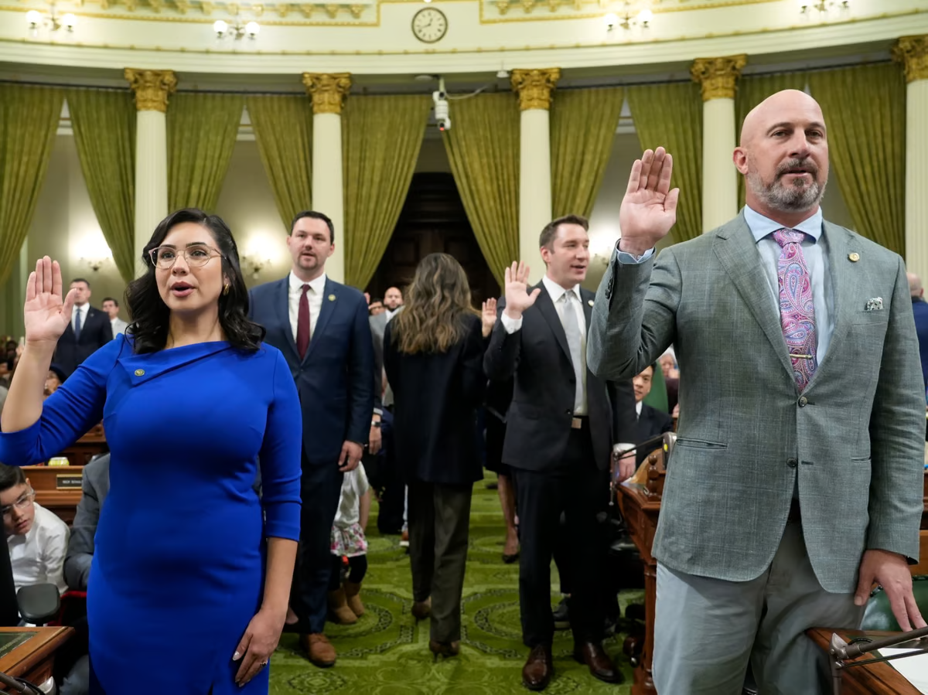
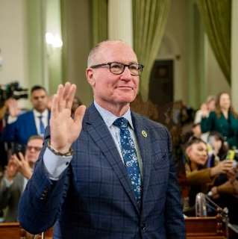
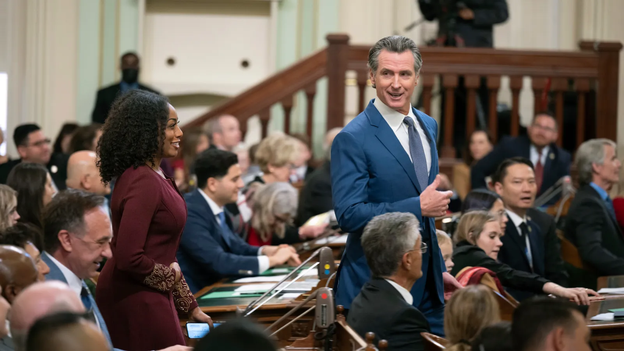
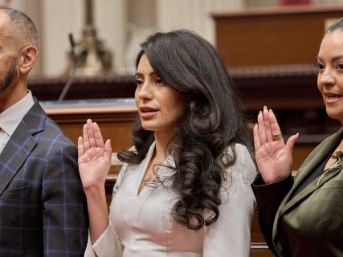
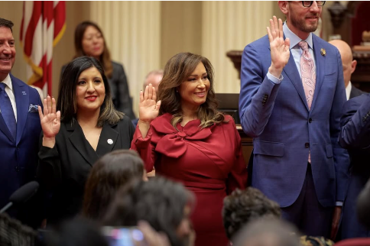
Assembly and Senate Convening- Dec. 2024
Assembly
All 79 assembly members were sworn in, including 23 new members
There is one vacancy (AD 32) as Vince Fong was elected but chose to keep his Congressional seat, special election will be held on April 29th, 2025
Senate
All 20 Senators were sworn in, including 12 new members, 8 of whom are former assembly members
Senator Nguyen (SD 36) has resigned as she was elected to the OC Board of Supervisors, a special session will be called on April 29th, 2025

Slide 45
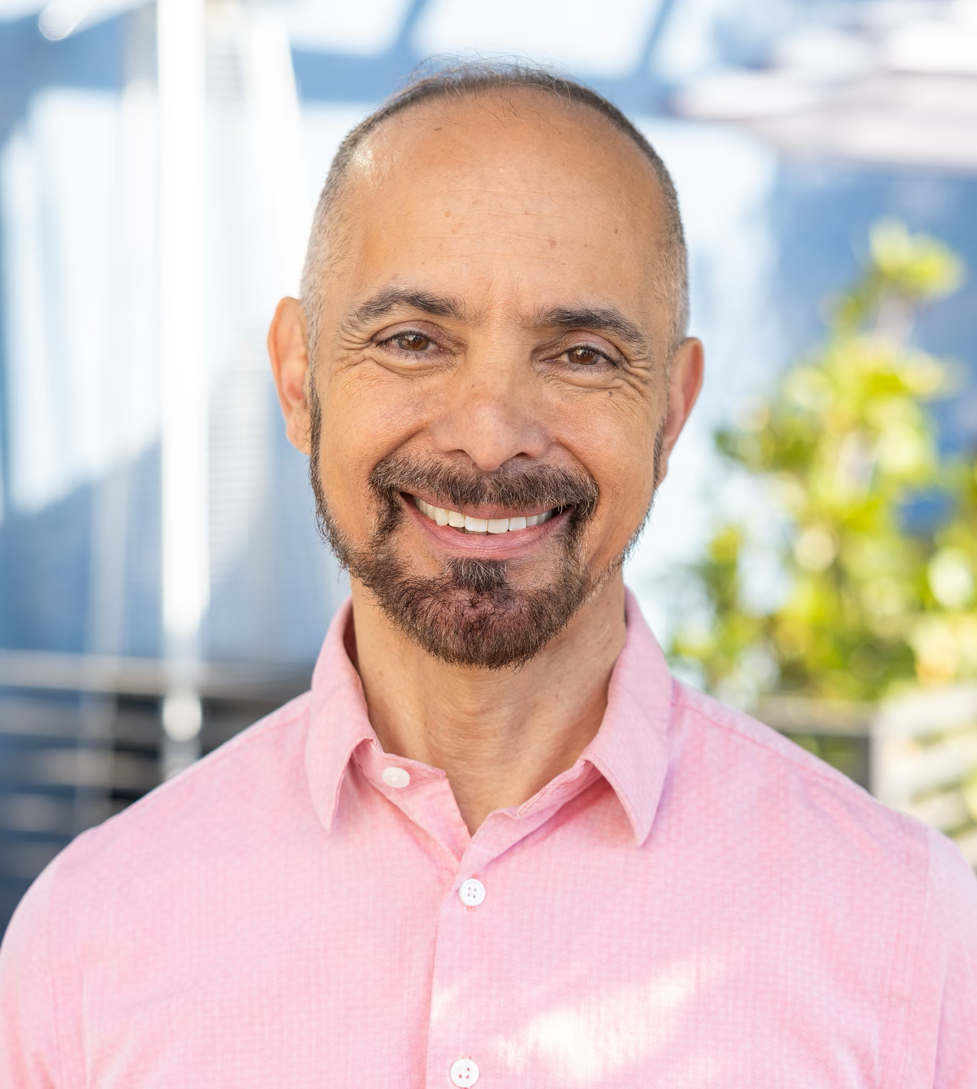
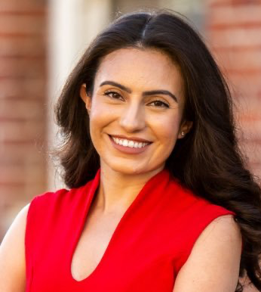
New Senator Highlights
Senator-elect Christopher Cabaldon (SD 3)
Community Colleges: Diablo Valley College, Napa Valley College, Santa Rosa Junior College, Woodland Community College, Solano Community College
Senator-elect Sasha Renee Perez (SD 25)
Community Colleges: Pasadena City College, Glendale Community College, Rio Hondo Community College, Citrus College
Notes:
Notes:
Out of the incoming senators, we want to highlight
Senator-elect Christopher Cabaldon (SD 3)- Dodd’s seat
Community Colleges: Diablo Valley College, Napa Valley College, Santa Rosa Junior College, Woodland Community College, Solano Community College, Los Medanos Community College,
Past Experience:
Mayor of West Sacramento
Vice Chancellor for Policy, Planning, and External Affairs for the California Community Colleges
Chief of State for State Assemblymember
Staff Director for the Assembly Committee on Higher Education
Senator-elect Sasha Renee Perez (SD 25) – Portantino’s seat
Community colleges: Pasadena City College, Glendale Community College, Rio Hondo Community College, Citrus College
Past Experience:
Mayor of City of Alhambra
Education Consultant
Education Commissioner with California 100 Initiative
Director of Public Affairs with the Campaign for College Opportunity

Slide 46
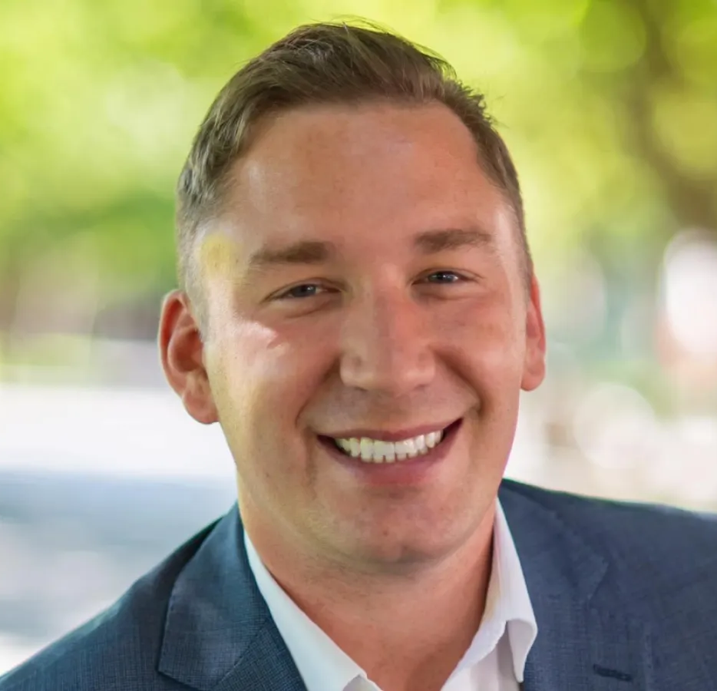
New Assembly Member Highlight
Assemblymember-elect Patrick Ahrens (AD 26)
Community Colleges: Mission College, De Anza College, San Jose City College
Notes:
Notes:
Out of the incoming assemblymembers, we want to highlight:
Patrick Ahrens
Past Experience:
President of the Foothill De Anza College Board of Trustees
District Director for Asm. Evan Low
Education
De Anza College Alumn

Slide 47
New Bill Limit
House Resolution (H.R.) 1 – Standing Rules, including reducing the bill introduction limit from 50 to 35 for the 2-year Session.
Senate Resolution (S.R.) 4 – Standing Rules, including reducing the bill introduction limit from 40 to 35 bills for the 2-year Session.
Notes:
The Assembly adopted: HR 1 – Standing Rules, including reducing the bill introduction limit from 50 to 35 bills for the 2-year Session. HR 2 – Chief Clerk and Chief Sgt. at Arms were elected HR 3 – Assembly organized and notified the Senate They also adopted SCR 2 – Legislative Counsel Jenkins was elected; SCR 1 – adoption of Joint Rules At 2pm, the Assembly convened the First Extraordinary Session. The Assembly adjourned at 2:15pm until Monday, January 6, 2025, at 1pm
The Senate adopted: SR 1 – concerning holdover Senators SR 2 – Senator McGuire elected PT, and Senate Secretary and Chief Sgt at Arms were elected SR 3 – 5 members of Rules Committee were elected, but PT said their members are likely to change when he announced committee assignments in January SR 4 – Standing Rules, including reducing the bill introduction limit from 40 to 35 bills for the 2-year Session. And budget trailer bills are not subject to SR 29.10. SCR 1 – Joint Rules SCR 2 – Election of Legislative Counsel SR 5 – Senate organized and notified GGN SR 6 – Senate organized and notified the Assembly At 1:15pm, the Senate convened the First Extraordinary Session. The Senate adjourned at 140pm until Monday, January 6, 2025 at 2pm

Slide 48
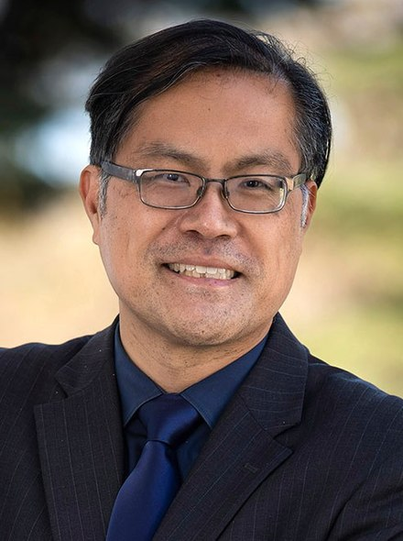
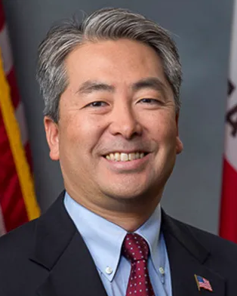
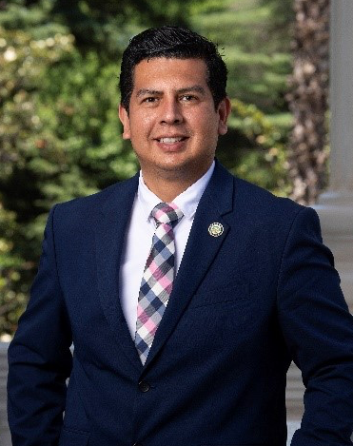
Assembly Committee Chair Appointments
Asm. Mike Fong
Chair, Higher Education
Asm. Al Muratsuchi
Chair, Education
Asm. David Alvarez
Chair, Budget Sub 3 on Education Finance

Slide 49
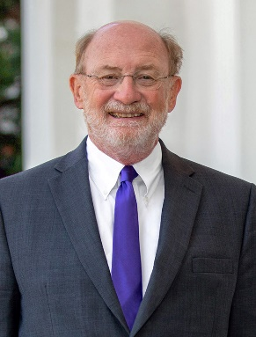
Senate Committee Membership
Senate Education Committee
Chair: Senator Sasha Renée Pérez (D- Alhambra)
Vice Chair: Senator Rosilicie Ochoa Bogh (R-Yucaipa)
Senator Christopher Cabaldon (D-Yolo)
Senator Steven Choi (R-Irvine)
Senator Dave Cortese (D-San Jose)
Senator Lena A. Gonzalez (D-Long Beach)
Senator Eloise Gómez Reyes (D-San Bernardino)
Senate Budget Sub 1 on Education
Chair: Senator John Laird (D-Santa Cruz)
Vice Chair: Senator Rosilicie Ochoa Bogh (R-Yucaipa)
Senator Sasha Renée Pérez (D-Alhambra)

Slide 50
2025 Preview

Slide 51
Possible Returning Legislation
*AB 1818 (Jackson) Homeless Students: Parking
Requires 20 CCC and 5 CSU campuses to develop a safe parking lot pilot program, allowing overnight parking by a homeless student if the student uses their vehicle as housing. *AB 90 (Jackson) overnight student parking Introduced on January 6, 2025.
AB 1160 (Pacheco) Student Debt Collection
Requires all higher education institutions to grant a one-time exemption from an enrollment or registration hold on a current or former student on the grounds that the student owes an institutional debt. This bill would also limit lost funds from being recouped through the Chancellor’s Office Tax Offset Program (COTOP).
SB 1388 (Archuleta) Education Finance: Reserves
Caps community college district reserves at an annual rate of 16.7%, unless a district participates in the part-time faculty health insurance program, the part-time faculty office hours program, and at least 75% of all credit instruction hours are taught by full-time faculty.
AB 2277 (Wallis) Part-time instructional hours
Increases the maximum amount of instructional hours that a part-time California Community College (CCC) faculty member may teach at any one community college district.

Slide 52
Legislation on the Horizon
Summary: Newly elected Asm. Patrick Ahrens is looking to introduce legislation related to abortion medication at the Community College system.
Background: Senator Connie Leyva’s SB 24 (2019) was signed into law to require the CSU and UC health centers to offer abortion medication to their students. The original version of this bill (SB 320, 2017), initially had CCC in its scope, but community colleges were quickly taken out of the bill.
Considerations:
Healthcare at CCC. Of the 113 community colleges, only 70 have health centers. Similar to CSU, the health centers are funded by its students’ fees and offer only “basic clinical care.”...On average, about one-third of the health center staff consists of registered nurses, 14% of whom are nurse practitioners, 4% are physicians, and 4% are licensed mental health professionals.
Capacity. Questioned whether these institutions can provide these services. In the case of community colleges, most of those health centers only offer fundamental services, such as first aid and assessment and referral functions.
Impact on student fees. Because campus health centers are all funded through fees on students, this bill may result in either shutting down the centers or substantial increases in student fees to pay for the additional services due to new staffing and equipment necessary to provide them.

Slide 53
Legislation on the Horizon
Summary:
The International Interior Design Association (IIDA) will be sponsoring legislation to create a state license for commercial interior designers.
If passed, community college graduates could not work in commercial interior design until they pass an expensive national examination ($1,335) and obtain a state license ($1,200 per year).
Violations of the new law would be subject to citations of up to $5,000 from the proposed Commercial Interior Design Technical Committee.
Previous legislative efforts:
AB 2482 (Ma, 2012)- Never heard in policy committee
SB 1312 (Yee, 2008)- Died on the Senate Floor
AB 2482 (Romero, 1999)- Vetoed by the Governor

Slide 54
Legislation on the Horizon
John Burton Advocates for Youth (JBAY) is proposing legislation to improve access to student housing for California’s most vulnerable students, those who have experienced foster care or homelessness, by enacting the following:
Require, rather than request, California Community Colleges to provide priority housing to current and former foster youth and homeless youth students, including priority for housing facilities that are open during academic or campus breaks.
Allow current and former foster youth and homeless youth students across all three public systems of higher education to reside in housing facilities established by the Higher Education Student Housing and Capacity Expansion Grant Program while enrolled in at least 6 units per semester rather than 12.

Slide 55
The Governor's Master Plan for Career Education
Executive Summary:
Create a State Planning and Coordinating Body
Strengthen Regional Coordination
Support Skills-Based Hiring Through a Career Passport
Develop Career Pathways for High School and College Students
Strengthen Workforce Training for Young People and Adults
Increase Access to and Affordability of Education and Workforce Training

Slide 56
Governor’s Proposed 2025-26 Budget: Ongoing Investments ($358.55 million)
The Governor’s budget proposes a 2.43% cost-of-living adjustment worth $230.39 million
Funds 0.5% for enrollment growth worth $30.44 million
Select categoricals and adult ed would also receive a 2.43% COLA worth $28.9 million
$30 million for the expansion of the Rising Scholars Network
$7 million for credit for prior learning and career passport
$29 million for the Statewide Common Data Platform

Slide 57
Governor’s Proposed 2025-26 Budget: One-Time Investments ($394.52 million)
$168 million for Statewide Technology Transformation
$133.5 million for the Statewide Common Data Platform
$93 million credit for prior learning and career passport

Slide 58
Thank You!

