Slide 1
State of SWACC
39 Years of Successful Operations

Slide 2
Welcome New Board & Committee Members
Eric Vreeman Board Member
Valarie Mitchell Board Member
Brittany Grice Board Member
Monica Martinez Board Member
Aurora Ayala Board Member
Janet Phillips
C&C Committee
Joel Peterson Board Member
Steve Haigler Board Member
Morgan Turner Board Member
Aimee Gallagher Board Member
Stacy Kimbrough Board Member
Jason Hinkle
Board Member
Karen Woods
UW Committee
Amir Nour
Board Member
Omar Gutierezz Board Member
First Timer
James Thomas Board Member
Kevin Gee
Board Member
Micaela Ochoa Board Member
Marilyn Morikang
Board Member
Board Member
Committee

Slide 3
Introductions

Slide 4
What/Who We Are
…was formed by the members
…to be governed by the members
…to protect the members
…to control costs
…and reduce risk

Slide 5
SWACC Mission
We do this by:
Providing Property & Liability coverage and resources specific to community college exposure
Developing specialized loss control programs and services
Implementing fiscally responsible self-funding and risk transfer programs
Leveraging the clout of 80% of all California Community Colleges
Mission Statement Policy
The Statewide Association of Community Colleges mission is to be the premier of Property & Liability programs for California Community College Districts

Slide 6
2024-2027 Goals and Strategic Initiatives
Provide Education and Training to Members
Mid-level Managers Risk Mitigation Engagement
Build Relationships Among Members
Mitigate Emerging Trends Risk
Student Housing Taskforce
Volunteer Guide
Strengthen SWACC’s Institutional Resilience
Succession Training for Leadership
New Member Orientation
Mentor/Mentee Program
Sample Waivers
Technology Committee

Slide 7
Exposures Covered
 | 1986 | 2017 | 2024
Number of Members | 18 | 49 | 58
Property Values | $900M | $15.5B | $30.6B
FTES | 151,000 | 593,000 | 684,000

Slide 8
Membership as of July 1, 2024
Foothill-De Anza CCD
Gavilan Jt. CCD
Glendale CCD
Hartnell CCD
Imperial CCD
Kern CCD
Lake Tahoe CCD
Lassen CCD
Long Beach CCD
Los Rios CCD
Marin CCD
Mendocino-Lake CCD
MiraCosta CCD
Monterey Peninsula CCD
Mt. San Antonio CCD
Mt. San Jacinto CCD
Allan Hancock Joint CCD
Antelope Valley CCD
Barstow CCD
Butte-Glenn CCD
Cabrillo CCD
Calbright College
Cerritos CCD
Chabot-Las Positas CCD
Citrus CCD
Coast CCD
College of the Sequoias
Compton CCD
Contra Costa CCD
Desert CCD
El Camino CCD
Feather River CCD
Siskiyous Joint CCD
Solano CCD
Sonoma County CCD
South Orange County CCD
Southwestern CCD
Ventura County CCD
Victor Valley CCD
West Hills CCD
West Kern CCD
West Valley-Mission CCD
Yuba CCD
Napa Valley CCD
Ohlone CCD
Palo Verde CCD
Palomar College
Pasadena Area CCD
Rancho Santiago CCD
Redwoods CCD
San Bernardino CCD
San Diego CCD
San Joaquin Delta CCD
San Jose/Evergreen CCD
San Luis Obispo County CCD
Santa Clarita CCD
Santa Monica CCD
Shasta-Tehama-Trinity Joint CCD
58 college district members

Slide 9
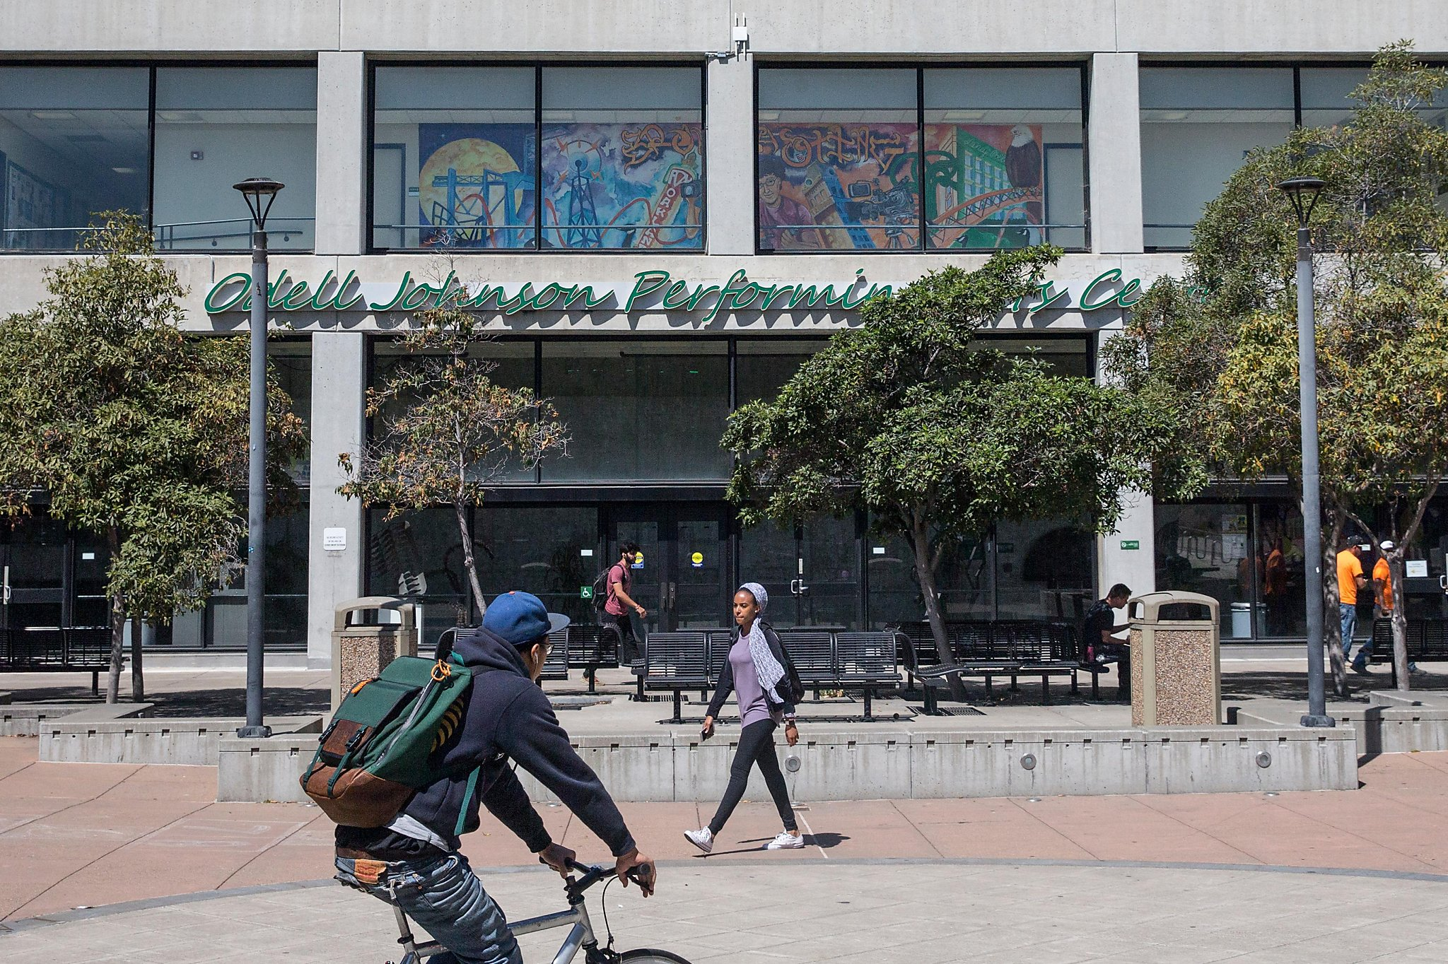
Welcome Our Newest Member

Slide 10
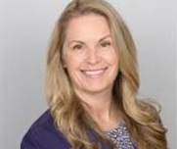
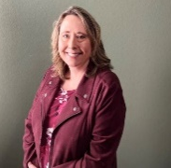
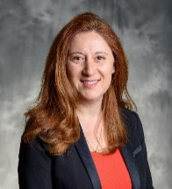
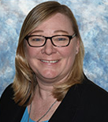
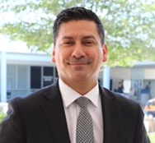
Organization & Governance
Board of Directors
58 Members
Executive Committee
Claims and Coverage Committee
April Marin, Chair
Santa Clarita CCD
Underwriting Committee
Debbie Turner, Chair
Los Rios CCD
Finance Committee
Claudette Dain, Chair
Citrus CCD
HR Committee
Cindy Vyskocil, Chair
South Orange County CCD
IT Committee Felipe Lopez, Chair Cerritos CCD

Slide 11
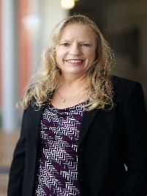
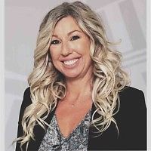
Executive Committee
Ann-Marie Gabel
Claudette Dain
Russi Egan
Jamie Ruggles
President
Vice President
Treasurer
Secretary
South Orange County CCD
Citrus CCD
Lake Tahoe CCD
Los Rios CCD
Keith Curry
Felipe Lopez
Darlene Inda
Christopher De La Rosa
Micaela Ochoa
Compton CCD
Cerritos CCD
Pasadena Area CCD
Foothill De Anza CCD
Bay Area Community College District JPA

Slide 12
How Does it Work
Board of Directors
Every Member Represented
Primary and Alternate Representatives
Weighted Votes based on Member Size
Executive Committee = 4 Officers + 5 At-Large
Officers serve two-year terms
Five (non-Executive) Committees + Roundtable
Any designated district rep can participate (Committee Representatives don’t have Alternates)
Only 1 member from a district can participate as a voting member
Roundtable meetings open to everyone

Slide 13
Program Structure - 2024/2025
PROPERTY
LIABILITY
$500,250,000
SAFER
$475,000,000
Excess
$25,250,000
SAFER
$25,000,000
Excess $50,000,000
$75,000,000
SAFER
$25,000,000
Excess $25,000,000
$50,000,000
SAFER
$15,000,000 Excess $10,000,000
Annual Aggregate Deductible $10M
$25,000,000
$25,250,000
SAFER
$25,000,000 Excess $250,000
$7,500,000
Annual Aggregate Deductible
SAFER
$8,000,000 Excess $2,000,000
Annual Aggregate Deductible $56M
$10,000,000
SAFER
$1,000,000 Excess $1,000,000
$2,000,000
$250,000
SWACC
Retention
$250,000 Less MRL
SWACC
Retention
$1,000,000 Less MRL
$1,000,000
Various
Member Retained Limit
Member Retained Limit
Various

Slide 14
SWACC Quick Facts
Not for Profit JPA
58 California Community College Districts
SAFER Excess Property and Liability – True Follow Form
2.8M ADA/FTES; $127B TIVs
492 California School Districts
58 California Community College Districts
Member Governance & Control
CAJPA Accredited with Excellence
Broad Property & Liability Coverage
Annual review of MOC to address emerging risks
Student Professional Liability
Medical Malpractice - Physicians, Allied Health Professionals and Mental Health Counselors
Directors and Officers
Employee Benefits E & O
Extended EPL Coverage
Injunctive Relief
Asbestos Defense & Indemnification
Breach of Contract
Cyber Liability
Active Assailant

Slide 15
SWACC Financial Strength at a Glance (6/30/24)
Since Inception:
$232.7M – Net Contributions
$29.0M – Net Investment Income Earned
$164.8M – Paid Claims & Loss Portfolio Transfer
$36.6M – Net Position Returned to Member Districts
$8.3M – Net Position Utilized for SWACC Programs
$38.2M – Claim Liabilities & ULAE
$10.1M – Undesignated Net Position/Capital Fund/Rate Stabilization

Slide 16
Member Services
Integrated Loss Control, Risk Financing and Claims Management Solutions
Community College Specialists
Keenan SafeColleges & P&C Bridge
Claims Administration-Property & Liability Claims Administration (PLCA)
Financial Services-Service Enhancement Technologies (SETECH)
Bi-annual Safety Site Inspections and Audits
Certified Playground Safety Inspections
Building Appraisals conducted every five years
Dedicated Loss Control Consultants

Slide 17
Trainings & Resources
Webinars and Roundtables
Focus on:
Best Practices Library
Webinars and Roundtables
Cyber Resources
Title IX
Dual Enrollment
Student Housing
SWACC 101
Title IX Trainings
Mental Health Webinars
Loss Driver Reduction Program
ADA/FEHA Trainings
Grand River Solutions Consortium
Employment Practices Liability Resources
Keenan SafeColleges
275 Courses Available

Slide 18
What if I Have a Claim?
What if I Have a Claim?
Brian Evans
NorCal Claims Manager
bevans@keenan.com
310-212-3344
Call Matt and Brian to open and claim file
Assign defense counsel if necessary
Triage to provide support and guidance if in early stages of claim/incident
SWACC will send a coverage determination once the C&C Committee reviews
Reservation of rights letter
Matthew Takeda
SoCal Claims Manager
mtakeda@keenan.com
310-212-0363 x2666

Slide 19
Early Triage – Liability
Early Triage – Liability
Allowing early review and assistance on potentially covered claims and other claims listed in the Memorandum of Coverage before litigation is filed greatly assists in a better defense and cost effective/earlier resolution.
Notes:
Early Triage is the process of identifying incidents or loss occurrences that may result in a covered loss under the Memorandum of Coverage (MOC).
The earlier that notification, and discussions between the Member and the PLCA Branch Claims Manager take place, the sooner those losses can be referred to panel counsel and achieve early resolution. If there is potential for resulting in a claim under the MOC, it may be assigned a defense panel counsel to coordinate and consult with the Covered Agency and its General/Labor Counsel to minimize the overall tort liability exposure.
The MOC requires that the following types of third party claims be reported to the
Authority’s Claims Administrator:
Incurred 50% of MRL
• Fatality
• Errors & Omissions
• Discrimination*
• Spinal Cord Injury
• Loss of Limb
• Serious Head Injury
• Serious Burns
• Disfigurement
• Multiple Fractures
• Employment Practices*
• Physical/Sexual Abuse
• Civil Rights Violation*
• Loss of Any Senses
• Injunctive Non-Monetary
• Breach of Contract
Maximizing the Defense
• Panel counsel involved early
-- Understands the facts and circumstances
-- Has the documentation from early on
-- Investigation and discovery quickly initiated
• Huge advantage for early/cost effective resolution
Purpose
• Not intended to circumvent or eliminate your relationship with existing
general counsel
• This is a joint effort
-- Two sets of eyes from different perspectives
-- Protecting the District on two concurrent paths
-- Understanding the downside risks and potential consequences in the
decision making process

Slide 20
Claim Workflow
Claim Workflow
Claim submitted by District
Manager/Supervisor review claim and assigns to dedicated Examiner
Manager/Supervisor approves all written communication – Acknowledgement letter forwarded by administrator
Claim set up within 24 hours
Assigns investigator/ DA/appraiser as needed
Identifies any subrogation potential
Manager/ Supervisor reviews final file closing
Examiner analyzes loss and determines plan of action

Slide 21
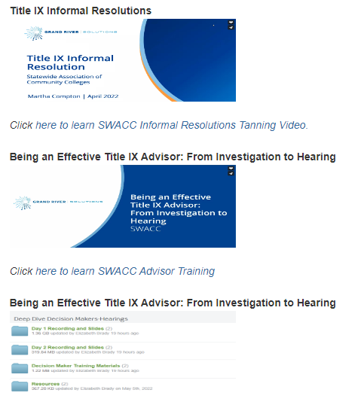
SWACC Website
Home (Special Bulletins, and Announcements, Legislative Summaries)
About (History, Membership, Mission, Benefits, Annual Report)
Services
The “Member Resources” section:
Finance (Treasurer’s Reports, Financial Audit Reports, Investment Reports)
Administration (Governing Documents, Policies & Procedures, Program Structure, Forms)
Claims (Reporting a Claim, Defense Attorney Panel)
Underwriting (Checklists, Assessment Tools)
Title IX Library
Agenda Packets (Full packets available online)
Best Practices Library

Slide 22
Upcoming Meetings
02/03/25 Claims & Coverage (San Diego)
03/28/25 Underwriting/Member Services (Millbrae)
04/25/25 HR Committee (Zoom)
Coming in March 2025
IT Committee

Slide 23
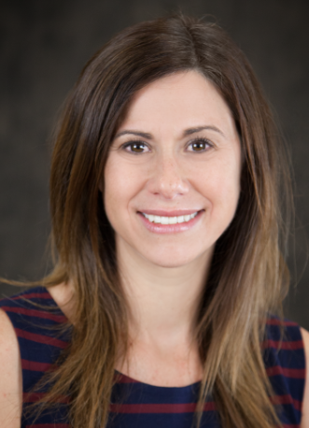
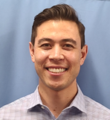
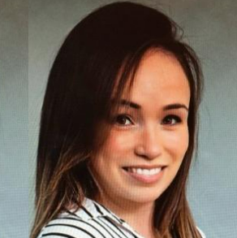
SWACC Support
Questions about and correspondence related to Board and committee meetings
Coordination of committee attendance
Assistance with SWACC’s resources
Travel reimbursement for meetings and conference
Colleen Bjerknes
SWACC JPA Manager
cbjerknes@Keenan.com
310-212-0363 x2614
Jeff Ostrom
Super Pool Account Manager
jostrom@Keenan.com
310-212-3344 x5182
Jennifer Ibarra
Super Pool Account Coordinator
jibarra@Keenan.com
310-212-0363 x2656

Slide 24
Program Of Events

Slide 25
Program of Events
Legislative Update
Humans Say the Darndest Things! But…Is It Protected Speech or Unlawful Conduct?
Behind the Curtain: Exploring The Cyber Threat Landscape

Slide 26
Program of Events
Risk Happens: Contract Smarter, Not Harder
Supporting Supervisor In Their Role in Workplace Violence Prevention
Employment Practice Liability Workshop

Slide 27
Thank You!

